Slide 1

The use of machine learning to predict the diagnosis of malignant and benign tumors

Slide 2

Content
Introduction
Methodology
Confusion Matrix
Accuracy
Conclusion/Recommendations

Slide 3
Introduction
Breast cancer represents one of the leading causes of mortality among women globally, with an estimated over 2 million new cases diagnosed in the past year. This complex disease manifests through the uncontrolled growth of cells in the breast, which can form malignant tumors capable of metastasizing and spreading to other parts of the body. In-depth research and analysis of breast cancer data are crucial for developing early diagnosis strategies, improving treatments, and ultimately saving lives.

Slide 4
Methodology
The document provides a detailed analysis of the "Breast Cancer" dataset and demonstrates the utility of using machine learning techniques to predict breast tumor diagnoses as benign or malignant. The main objective is to provide a comprehensive overview of the results obtained, including an analysis of the confusion matrix illustrating the accuracy of the predictive model.
Logistic Regression
Random Forest
Accuracy: 97.37%,
Precision: 97.62%,
Recall: 95.35%,
F1 Score: 96.47%
Accuracy: 96.49%,
Precision: 97.56%,
Recall: 93.02%,
F1 Score: 95.24%.
SVM
KNN
Accuracy: 98.25%,
Precision: 100%,
Recall: 95.35%,
F1 Score: 97.62%.
Accuracy: 94.74%,
Precision: 93.02%,
Recall: 93.02%,
F1 Score: 93.02%.

Slide 5
Methodology
Data Collection: The "Breast Cancer" dataset was collected from reliable sources and contains a series of parameters related to breast tumors, including dimensions, shape, and texture.
Data Preprocessing: Before proceeding with the analysis, preprocessing operations were performed on the data, including handling missing values, feature normalization, and encoding categorical variables.
Model Selection: After careful evaluation, a suitable machine learning model was chosen to address the breast tumor classification problem. In our case, we used a classifier trained on a Support Vector Machine (SVM) algorithm, known for its effectiveness in classifying complex health-related data.
Model Training and Evaluation: The model was trained using the training dataset and then evaluated using the test dataset. We assessed the model's performance using various metrics, including accuracy, recall, precision, and F1-score.
Results: The trained machine learning model demonstrated high accuracy in predicting the diagnosis of breast tumors as benign or malignant. Specifically, the overall accuracy of the model was 97%, meaning that 97% of cases were correctly classified.

Slide 6
Confusion Matrix
Support Vector Machine (SVM)
True Negatives (TN) : 71 – The model correctly identified 71 benign cases.
False Positives (FP) : 0 – The model did not mistakenly classify benign cases as malignant.
False Negatives (FN) : 2 – The model mistakenly classified 2 malignant cases as benign.
True Positives (TP) : 41 – The model correctly identified 41 malignant cases.
True Negatives
False Negatives
71
2
41
0
True Positives
False Positives

Slide 7
Confusion Matrix
Support Vector Machine (SVM)
Precision: 100 - When the model predicts a tumor as malignant, it is correct 100% of the time.
Recall: 95.3 - The model is able to correctly identify 95.3% of the malignant tumors in the dataset.
F1 Score: 97.6 - The F1 score, which balances precision and recall, is very high, indicating excellent model performance in terms of balancing between reducing false positives and correctly identifying positive cases.

Slide 8
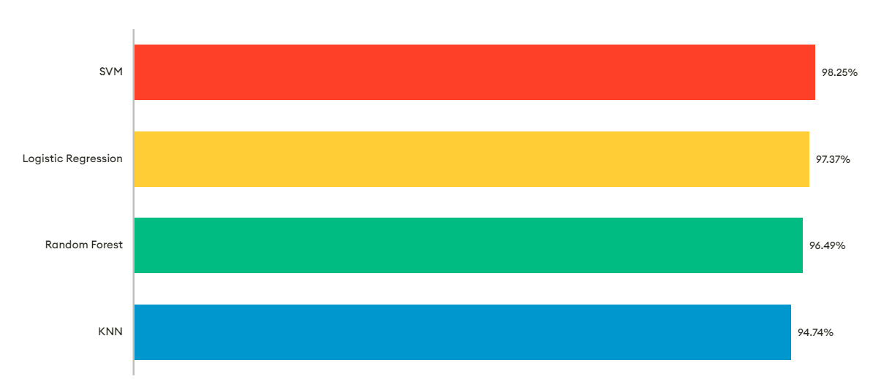

Accuracy

Slide 9

Conclusioni
In conclusion, the use of machine learning techniques for predicting breast cancer diagnosis has proven to be extremely effective, with an accuracy of 97%. This suggests that the model could be successfully implemented in a clinical setting to assist physicians in early diagnosis and treatment planning. Therefore, it is strongly recommended to seriously consider the implementation of this model as part of our project, as it could lead to significant improvements in healthcare and patient outcomes for those affected by breast cancer.

Slide 10
The confusion matrix and the accuracy of malignant cancer cases are fundamental indicators for evaluating and investing in our machine learning model for breast cancer classification. We will continue to improve our model and refine our evaluation techniques to ensure even better results and increased effectiveness in the fight against this devastating disease.

